Slide 1
Q10: Complete subroutine plot gene and write a Perl program to plot the structure of human genes using SVG.

Slide 2
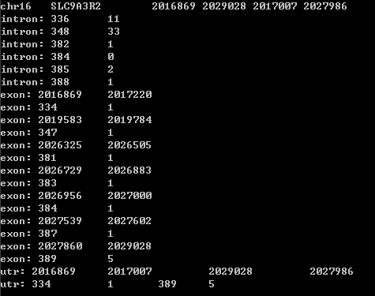
Output

Slide 3
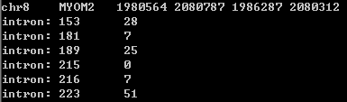
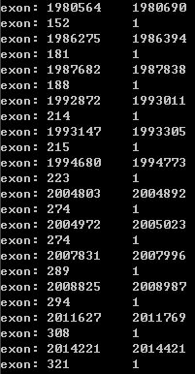

Output
$left_margin_width
sub plot_ruler
$genomic_position_end
$gene->get_chrom

Slide 4
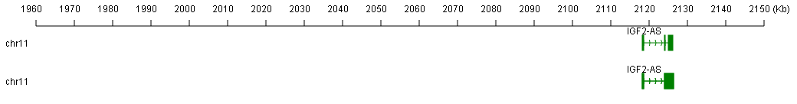
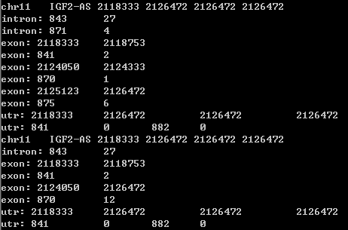
Output
my $x1= int(($exon_beg[$i]- $genomic_position_start)/$scale) + $left_margin_width

Slide 5
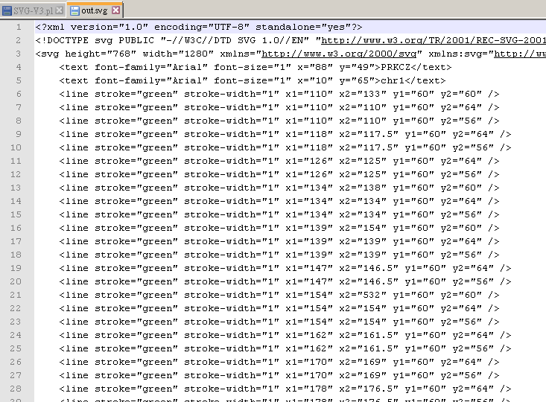
Output

Slide 6
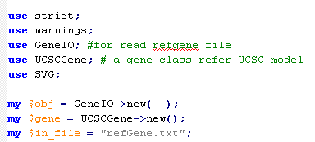
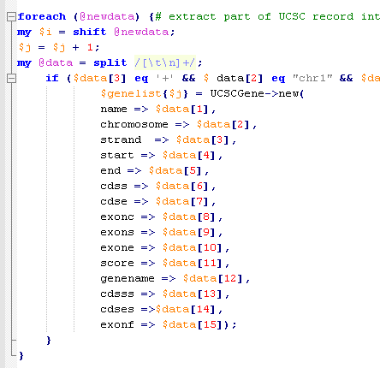

Overview
Resue module
Use UCSC object
Pass UCSC gene object into subroutine

Slide 7
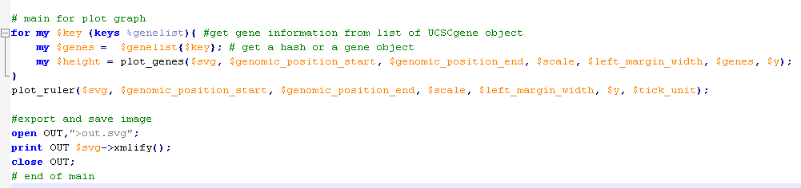
Main
Draw in $svg object and output as XML and output.svg

Slide 8
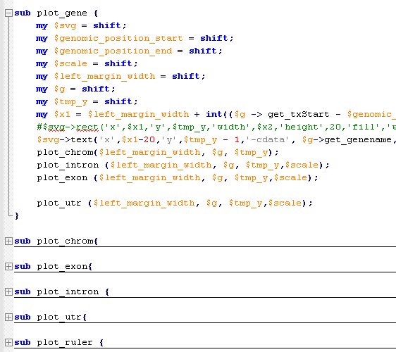
Subroutine

Slide 9
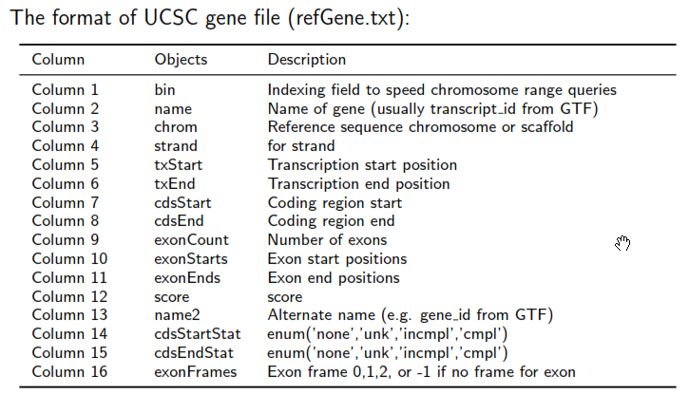
Calculation
Difference between txStart and cdsStart to get UTR
For loop to list exon

Slide 10
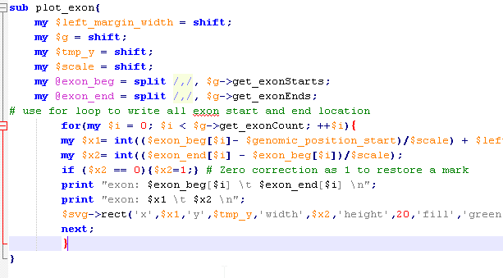
Calculation
Zero correction after scaling and round up

Slide 11
- END -

